Slide 1
Technical Presentation-MySQL-Understanding SQL Joins
Inner, Left, Right, Cross, Sell Joins, Full outer join
Presented By-Manjunath MM
Date: 22-11-2023

Slide 2
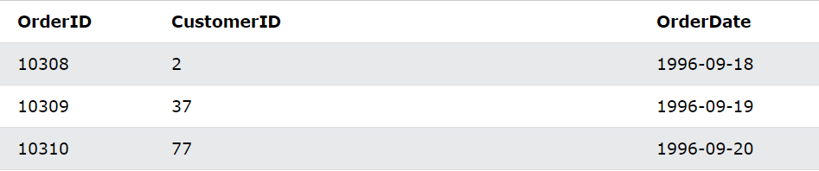
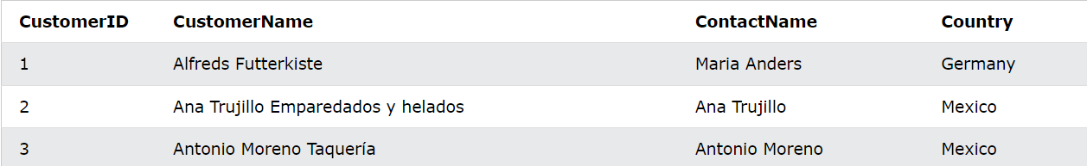
Meaning of Joins
A JOIN clause is used to combine rows from two or more tables, based on a related column between them.
Joins are fundamental in databases because they allow the retrieval and combination of data from multiple tables.
Let's look at a selection from the “Orders” table/ “Customer” Table

Slide 3
Here are a few reasons why joins are crucial in databases:
Data Normalization
Relation between Tables
Query Flexibility
Efficient Data Retrieval
Data Analyses Reporting
Maintaining Data Integrity

Slide 4
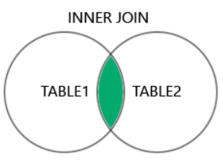
Types of Joins in MySQL:
Inner Join
Left Join
Right Join
Cross Join
1.Inner Join: The Inner Join keywords select records that have matching values in the both tables.
The Inner Join keywords selects all rows from both tables as long as there is a match between the columns. If there are records in the “orders” tables that do not have matches in “customers” these orders will not show.

Slide 5
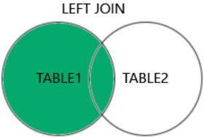
2. Left Join:
Thes Left Join keywords returns all records from the table (tables1), and the matching records (If any) from the right table(table2).
The LEFT JOIN keyword returns all records from the left table (Customers), even if there are no matches in the right table (Orders).

Slide 6
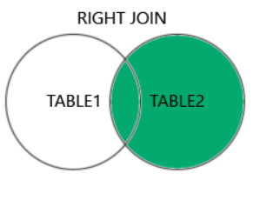
Right Join:
The RIGHT JOIN keyword returns all records from the right table (table2), and the matching records (if any) from the left table (table1).
The RIGHT JOIN keyword returns all records from the right table (Employees), even if there are no matches in the left table (Orders).

Slide 7
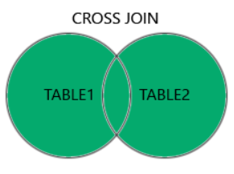
Cross Join:
The CROSS-JOIN keyword returns all records from both tables (table1 and table2).
CROSS JOIN can potentially return very large result-sets!
The CROSS-JOIN keyword returns all matching records from both tables whether the other table matches or not. So, if there are rows in "Customers" that do not have matches in "Orders", or if there are rows in "Orders" that do not have matches in "Customers", those rows will be listed as well.

Slide 8
Self-Join
A self join is a regular join, but the table is joined with itself.
It is used when you want to combine rows from the same table based on a related column within that table.
This involves aliasing the same table with different name to differentiate between the instance of the table being joined.
It is often used to compare rows within a table or retrieve hierarchical data stored within the same table structure.

Slide 9
Full Outer Join:
The FULL OUTER JOIN command returns all rows when there is a match in either left table or right table.
The FULL OUTER JOIN keyword returns all the rows from the left table (Customers), and all the rows from the right table (Orders). If there are rows in "Customers" that do not have matches in "Orders", or if there are rows in "Orders" that do not have matches in "Customers", those rows will be listed as well.

